Slide 1
Facebook user profiling
Surabhi Agrawal, Swati Garg, Kebra Thompson
TCSS 555 June 8, 2015

Slide 2
Problem Statement
Data:
Status Updates
Profile Pictures
Page Likes
Prediction Problems:
Age : Classification
Gender : Classification
Personality Traits : Regression

Slide 3

Dataset
I'm good. How are you?,http://www.astrology-numerology.com/ I'm an Aries/Capricorn. What are you?,??????????????????????,Hi!,Fake hair, fake nails, fake tan, Girl, are you sure you weren't made in China?,You can close your eyes to the things you do not want to see, but you cannot close your heart to the things you do not want to feel.,Happy valentines day everyone!!!!!!,damn im
6b5687946746267c45a81b0d52e78d06,1325680834230631649630,
6b5687946746267c45a81b0d52e78d06,1325997567760201649631,
6b5687946746267c45a81b0d52e78d06,1326069601067391649632,
6b5687946746267c45a81b0d52e78d06,1327170067688591649633,
6b5687946746267c45a81b0d52e78d06,1327429201265651649634,
6b5687946746267c45a81b0d52e78d06,1327677200992711649635,

Slide 4
Page Likes: User-Page-User
Description:
Predicts age, gender and personality scores.
2) We maintain a dictionary of the users who like each page. Eg: {Page1: [User1, User5], Page2: [User5, User6]......}.
3) When we encounter a new instance of the form User10 : [Page 2, Page7, Page9], we obtain the class labels for each of those users and take a majority for classification problem and average for regression problem for prediction.

Slide 5
Page Likes: User-Page-User
Feature Selection: We only select pages which have 0-50 users. We came to this value for threshold by trial and error.
Why UPU: Since information about a page is obtained by the users liking it, we can obtain the labels for the new instance by combining the information of all the users liking pages, which are also liked by the new instance.

Slide 6
Page Likes -
Logistic Regression
Description:
Used Logistic Regression classifier to predict age and gender.
2) Feature Selection: We only select pages which have 4-200 users (around 128,000 pages). We came to this value for threshold by trial and error.
3) Library used: http://scikit-learn.org/stable/modules/generated/sklearn.linear_model.LogisticRegression.html

Slide 7
Page Likes -
Logistic Regression
Naive Bayes models the densities of classes and selects the class that most likely produces the features.
Logistic Regression has a different approach - they try to model class boundary and membership directly, e.g. in a simple 2-feature dimension case this could mean trying to finding the line that best separates the classes (in >3 feature dimensions case it would be looking for the hyperplane that best separate classes).

Slide 8
Page Likes
Other Models Tried:
KNN full feature set
KNN feature selection
KNN Number of page likes per user
KNN page popularity buckets
KNN page popularity buckets using weights
Jaccard distance
KNN Union-Intersection
SVM

Slide 9
Images
Oxford Features
Random Forest for gender and age
Linear Regression for personality traits
Feature Selection
Manual elimination of some features
Libraries Used
www.scikit-learn.org
www.numpy.org
http://www.pythonware.com/products/pil/

Slide 10
Images
Other models tried
SVM on image pixels
KNN on Oxford features

Slide 11
Text
Naive Bayes:
Used to predict age and gender
Feature selection: Created the bag of words for the user comment
Removed the stop word
Calculated the freq for each word
Selected the top 500 features
Naive bayes is the most popular method for text classification
Libraries:
www.nltk.org
www.scikit-learn.org
www.numpy.org

Slide 12
Text
Linear Regression:
Used to predict the big5 personality traits
Regression problem
Feature Selection: Used LIWC features
Also tried using NRC features
Libraries:
www.scikit-learn.org
www.numpy.org

Slide 13
Text : Models Tried
Age and Gender Classification:
- Tried bigrams: The accuracy was not good
big5 personality traits:
- Used nrc features but did not see any change in the results
- Tried decision trees
References Used:
https://www.aaai.org/ocs/index.php/ICWSM/ICWSM13/paper/viewFile/6245/6309
https://canvas.uw.edu/courses/1029003/files/folder/project-papers?preview=34615628

Slide 14
Evaluation Methods
Baseline:
created the baseline for each trait. The baseline is used to compare the efficiency of the model.
The model generated should perform better than the baseline
Computed the majority age bracket and gender for age and gender for the baseline
Computed the average of the personality traits.
Accuracy: for classification evaluation
Root mean square error: regression

Slide 15
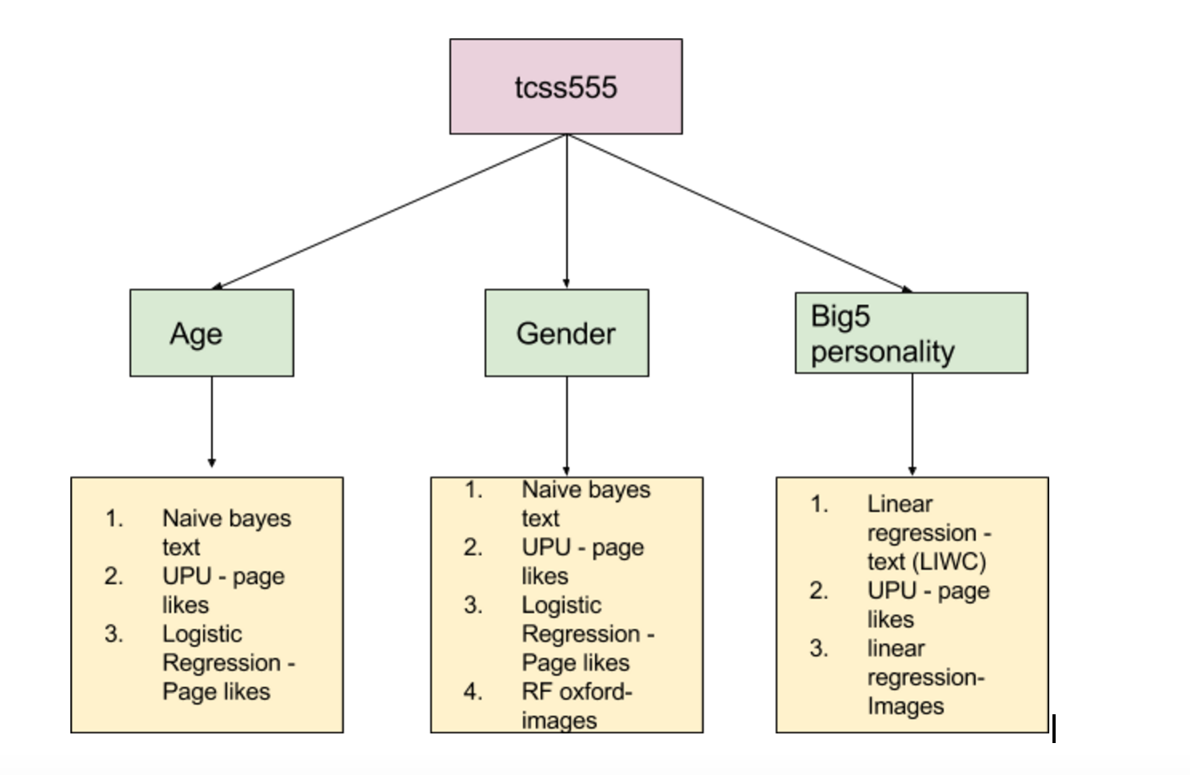
Merging

Slide 16
Merging
Majority Voting Method
Age Gender Prediction:
Calculated the Majority Gender from the following models:
Page Likes: Logistic regression
Page Likes: User page user
Images- Random Forest (oxford features)
Text - naive Bayes (bag of words)
Calculated the Majority age from the following models:
Page Likes: User page user
Page Likes: Logistic regression
Text - naive bayes (bag of words)

Slide 17
Merging
Big 5 Personality traits
Took the average of the big5 from the following model
Page likes: user page user
Images: random forest(oxford features)
Text: linear regression(LIWC)

Slide 18
Results
 | Age | Gender | Open | Neu | Ext | Agr | Con
Baseline | .59 | .59 | .65 | .80 | .79 | .66 | .73
RF Oxford (train data) | .53 | .83 | - | - | - | - | -
LinReg Oxford (train data) | - | - | .60 | .70 | .78 | .66 | .77
UPU | .60 | .71 | 0.65 | 0.79 | 0.79 | 0.65 | 0.72
Log Regr (train data) | .66 | .78 | - | - | - | - | -
NB Text | .61 | .71 | - | - | - | - | -
LinReg Text (LIWC) | - | - | 0.65 | 0.79 | 0.79 | 0.65 | 0.72
LinReg (LIWC+NRC) | - | - | 0.65 | 0.79 | 0.79 | 0.65 | 0.72

Slide 19
Final Results
 | Age | Gender | Open | Neu | Ext | Agr | Con
Baseline | 0.59 | 0.59 | 0.65 | 0.80 | 0.79 | 0.66 | 0.73
Final Model | 0.61 | 0.85 | 0.63 | 0.79 | 0.78 | 0.66 | 0.72

Slide 20
Challenges
The text files are in the latin-1 format instead of unicode. So decoding the text data into unicode was a challenge on VM
used fileComment.read().decode('latin-1')
It was very difficult to find techniques that worked for page likes, including feature selection.
Image processing presented software challenges.
One of the main challenges we faced was predicting the age accurately due to bias toward the ‘xx-24’ class.

Slide 21
Future work
Need to find better feature selection methods for big5 personality traits.
Come up with different methods for predicting big5 personality traits accurately.
Find ways to increase the age accuracy.

